Slide 2
David Miller
President
dmiller@emamsolutions.com
Anoop Thomas
Director of Technologies
athomas@emamsolutions.com
Chuck Buelow
V.P. of Business Development
cbuelow@emamsolutions.com

Slide 3
EMAM, Inc has been meeting the needs of leading organizations worldwide since 2006 and has been a long-time technology partner with 90 plus partners. EMAM is a privately held company Delaware corporation based in New York City, NY
New York
Los Angeles
North Carolina
India

Slide 4
Deliver / Share
Organize
Organize
Create
Collaborate
Acquire
Archive

Slide 5
Acquire
Live Stream / Baseband
Cloud Upload
Application – EMAM Feeder or Web App
XML & API
Next Slide

Slide 6
Organize
Categories with Permissions
Project Management
Next Slide

Slide 7
Create
Next Slide

Slide 8
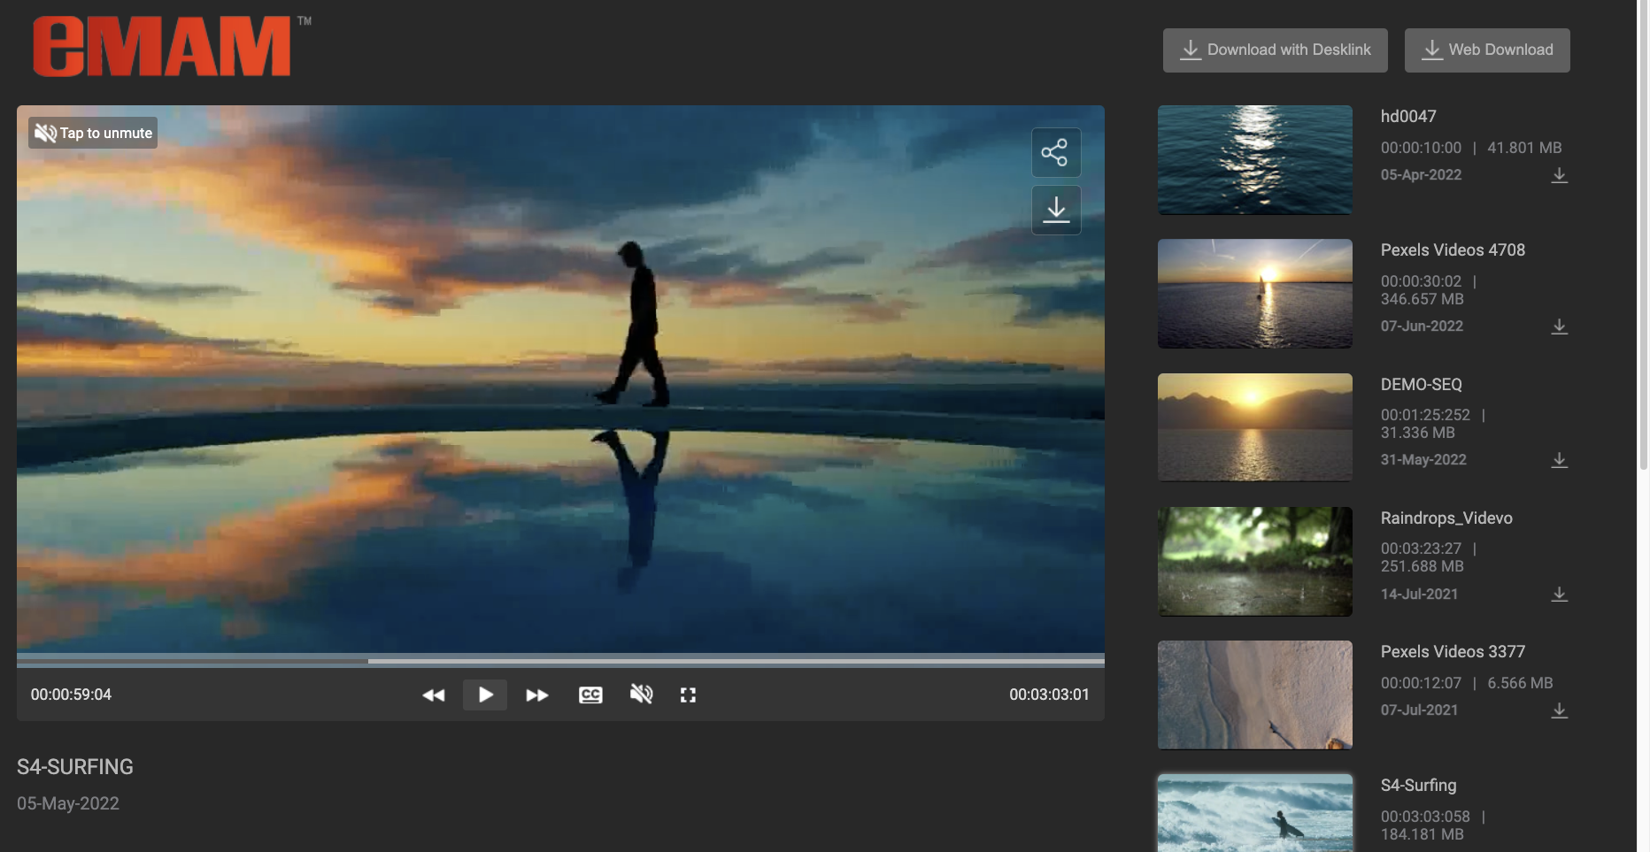
Collaborate
Next Slide

Slide 9
Deliver / Share
Social Media
Packaged Media
WEB / VOD
Broadcast/ TV / NEWS
Next Slide

Slide 10
Archive
Cloud Deep archive
LTO Tape Library
Spinning Disk / Object Storage
Next Slide

Slide 11
Why
Secure: SOC2, ISO 27001, DR, Secure sharing, Stable Company

Slide 12
Why
Secure: SOC2, ISO 27001, DR, Secure sharing, Stable Company
Affordable: SaaS/PaaS/Licensed, Scalable, Configurable for low TCO, Streamline search & Automated Processes to save labor costs, Control infra costs

Slide 13
Why
Secure: SOC2, ISO 27001, DR, Secure sharing, Stable Company
Affordable: SaaS/PaaS/Licensed, Scalable, Configurable for low TCO, Streamline search & Automated Processes to save labor costs, Control infra costs
Flexible: Work in cloud, on-premise, or hybrid; 100 integrated technologies and scores of worldwide system integrators

Slide 14
Why
Secure: SOC2, ISO 27001, DR, Secure sharing, Stable Company
Affordable: SaaS/PaaS/Licensed, Scalable, Configurable for low TCO, Streamline search & Automated Processes to save labor costs, Control infra costs
Flexible: Work in cloud, on-premise, or hybrid; 100 integrated technologies and scores of worldwide system integrators
Easy: Search +/- AI, Automated, Interoperable, Use your favorite web or editing interface

Slide 15
Best Practices
Collaborative Production
Local or Cloud based Servers, Database and Proxies
High-speed Storage local or cloud based
NLE workstations in cloud or remote
Optional Cloud solutions - LucidLink , Teradici options / configuration
EMAM Workgroup / 2 plus Dell Servers
Enterprise
Multiple cloud or lcal servers with fail-over, load-balancing, Redundancy
Microsoft services for backup and redundancy
Manage local SAN/NAS/LTO storage
Local and remote editing options
EMAM Enterprise / 5 plus Dell Servers
Archive System
Single Server - local db servers, transcoder and storage
Direct access to high-speed storage
LTO Library or Cloud Storage
Multi-layer support for storage
EMAM Vault / Publish / Dell Server

Slide 16
Deployment
emam cloud services
cloud-based db servers, transcoder and storage
High-available object storage
NLE workstations in cloud or remote
monthly / annual payments
emam hybrid
Cloud-based db servers & storage
Local application server for media processing
Manage local san/nas/lto storage
Local and remote editing options
emam on-premises
local db servers, transcoder and storage
Direct access to high-speed storage
NLE workstations with direct access to media
perform bulk tasks on assets

Slide 17
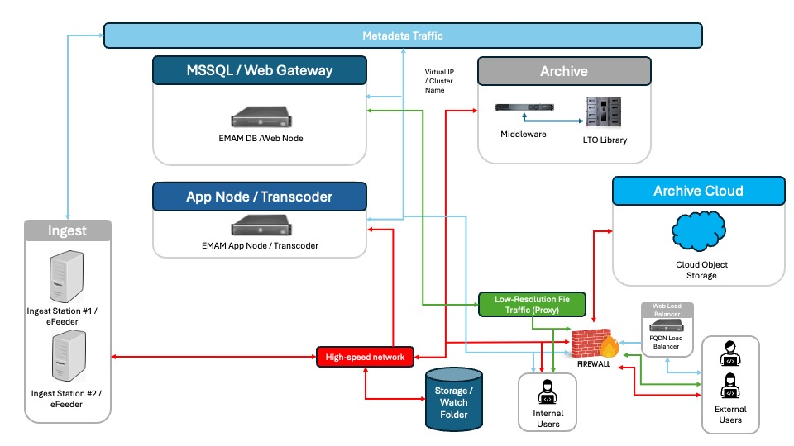
Deployment
emam on-premises
local db servers, transcoder and storage
Direct access to high-speed storage
NLE workstations with direct access to media
perform bulk tasks on assets

Slide 18
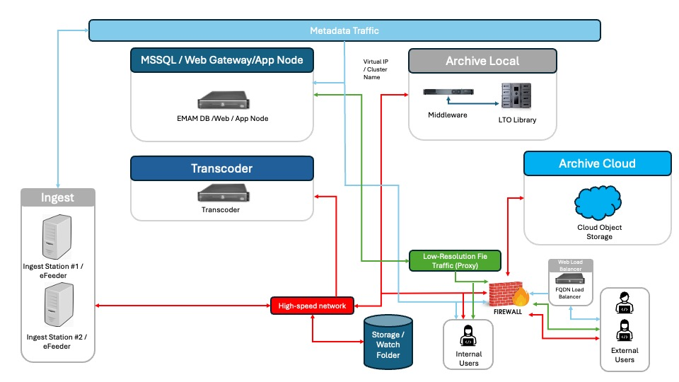
Deployment
emam on-premises
local db servers, transcoder and storage
Direct access to high-speed storage
NLE workstations with direct access to media
perform bulk tasks on assets

Slide 19
Deployment
User
User
emam cloud services
cloud-based db servers, transcoder and storage
High-available object storage
NLE workstations in cloud or remote
monthly / annual payments
User
eMAM DB
eMAM Web
CDN Edge
CDN Edge
eMAM App
Process Media
Share
Upload
Download
Browse

Slide 20
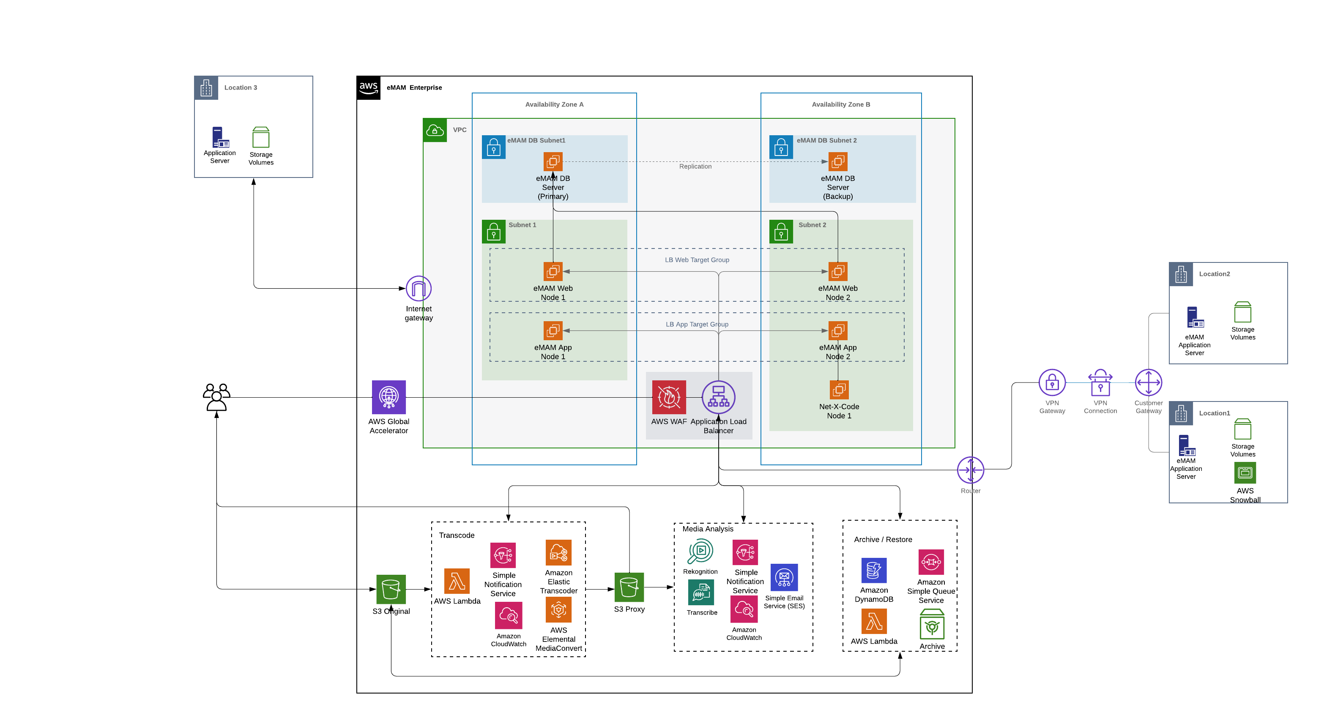
Deployment
emam hybrid
Cloud-based db servers & storage
Local application server for media processing
Manage local san/nas/lto storage
Local and remote editing options

Slide 21
Deployment
User
User
emam multi-site
Manage multiple sites
Public or private cloud / network
Local san/nas/lto
Media access from any location with permission
Move or copy media between locations
User
Share
eMAM DB
eMAM Web
Browse
Download
eMAM App
eMAM App
eMAM App
eMAM App
SAN
SAN
SAN
SAN
Upload
Upload
Upload

Slide 22
Component Based
SYSTEM MANAGEMENT
Servers | Organization Units
Features | Users/Groups/Permissions
Cloud/CDN | Storage and Archive
Ingest / Transcode systems | Delivery
Serverless | AI systems
Workflow Management | Analytics
SERVICE TIER
Ingest Service
Delivery Service
Cloud Service
Archive Service
Export Data Service
Web Services Gateway
CONNECTOR MODULES
Adobe Media Encoder | Harmonic WFS/Carbon
Telestream Vantage | Net-X-Code
Lambda - Elastic Transcoder / Media Convert | Command line – FFMPEG / FFMBC
AWS S3 | Azure BLOB
Google GCS | IBM COS
NetApp Storage Grid | Avid DS
NRCS - MOS Gateway | Social Media
Axis Camera | Matrox HDX
SGL FlashNet | Xendata
AWS Glacier | Dell EMC ECS
Spectra BlackPearl | FPD DivArchive
Quantum StorNext | Archiware P5
Atempo - ADA | Backblaze B2
1Beyond EZ Stor | QStar
Amazon Rekognition | Amazon Transcribe
Microsoft Video Indexer | MicrosFocus HPE IDOL
IBM Watson Speech to Text | Watson Video Enrichment
VoiceBase | IBM Cloud Video
YouTube | Brightcove
Zapier
DATA TIER
WORKFLOW
Ingest
Edit
Alerts
Review & Approval
Monetization
Cloud Distribution
Archive & Restore
Transcode & Delivery
AI Tagging
API Notification
Sidecar Delivery
Metadata Management
USER INTERFACE
eMAM Super Admin
eMAM Director
eMAM iPad App
eMAM Android App
eMAM Feeder
eMAM Desk Link App
Adobe CC – Panels (Premiere, AfterEffects, inDesign, Photoshop, Illustrator)
MSSQL
Server
BUSINESS INTELLIGENCE
Site Analytics
eBin Reports
User Reports
Asset State Reports
Asset History Reports
BUSINESS TIER
Business Service Layer
Business Logic Layer
Data Access Layer

Slide 23
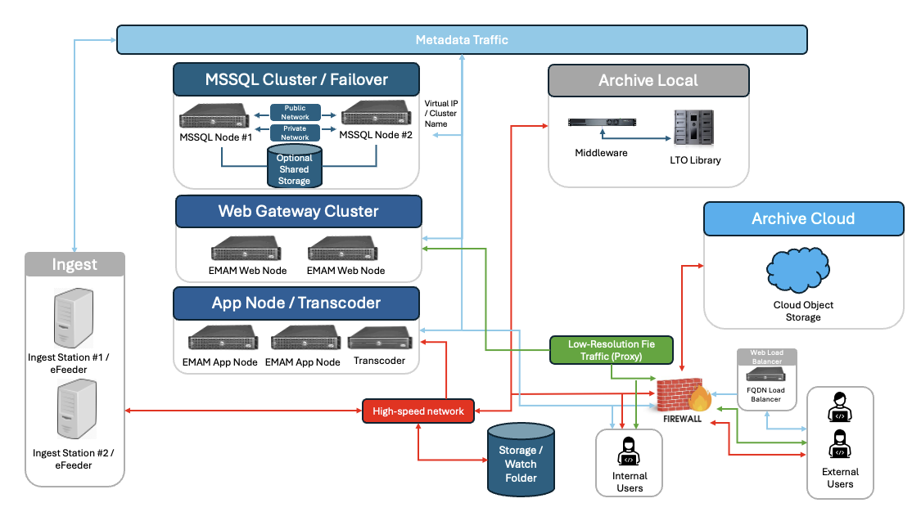
Enterprise Environment

Slide 24
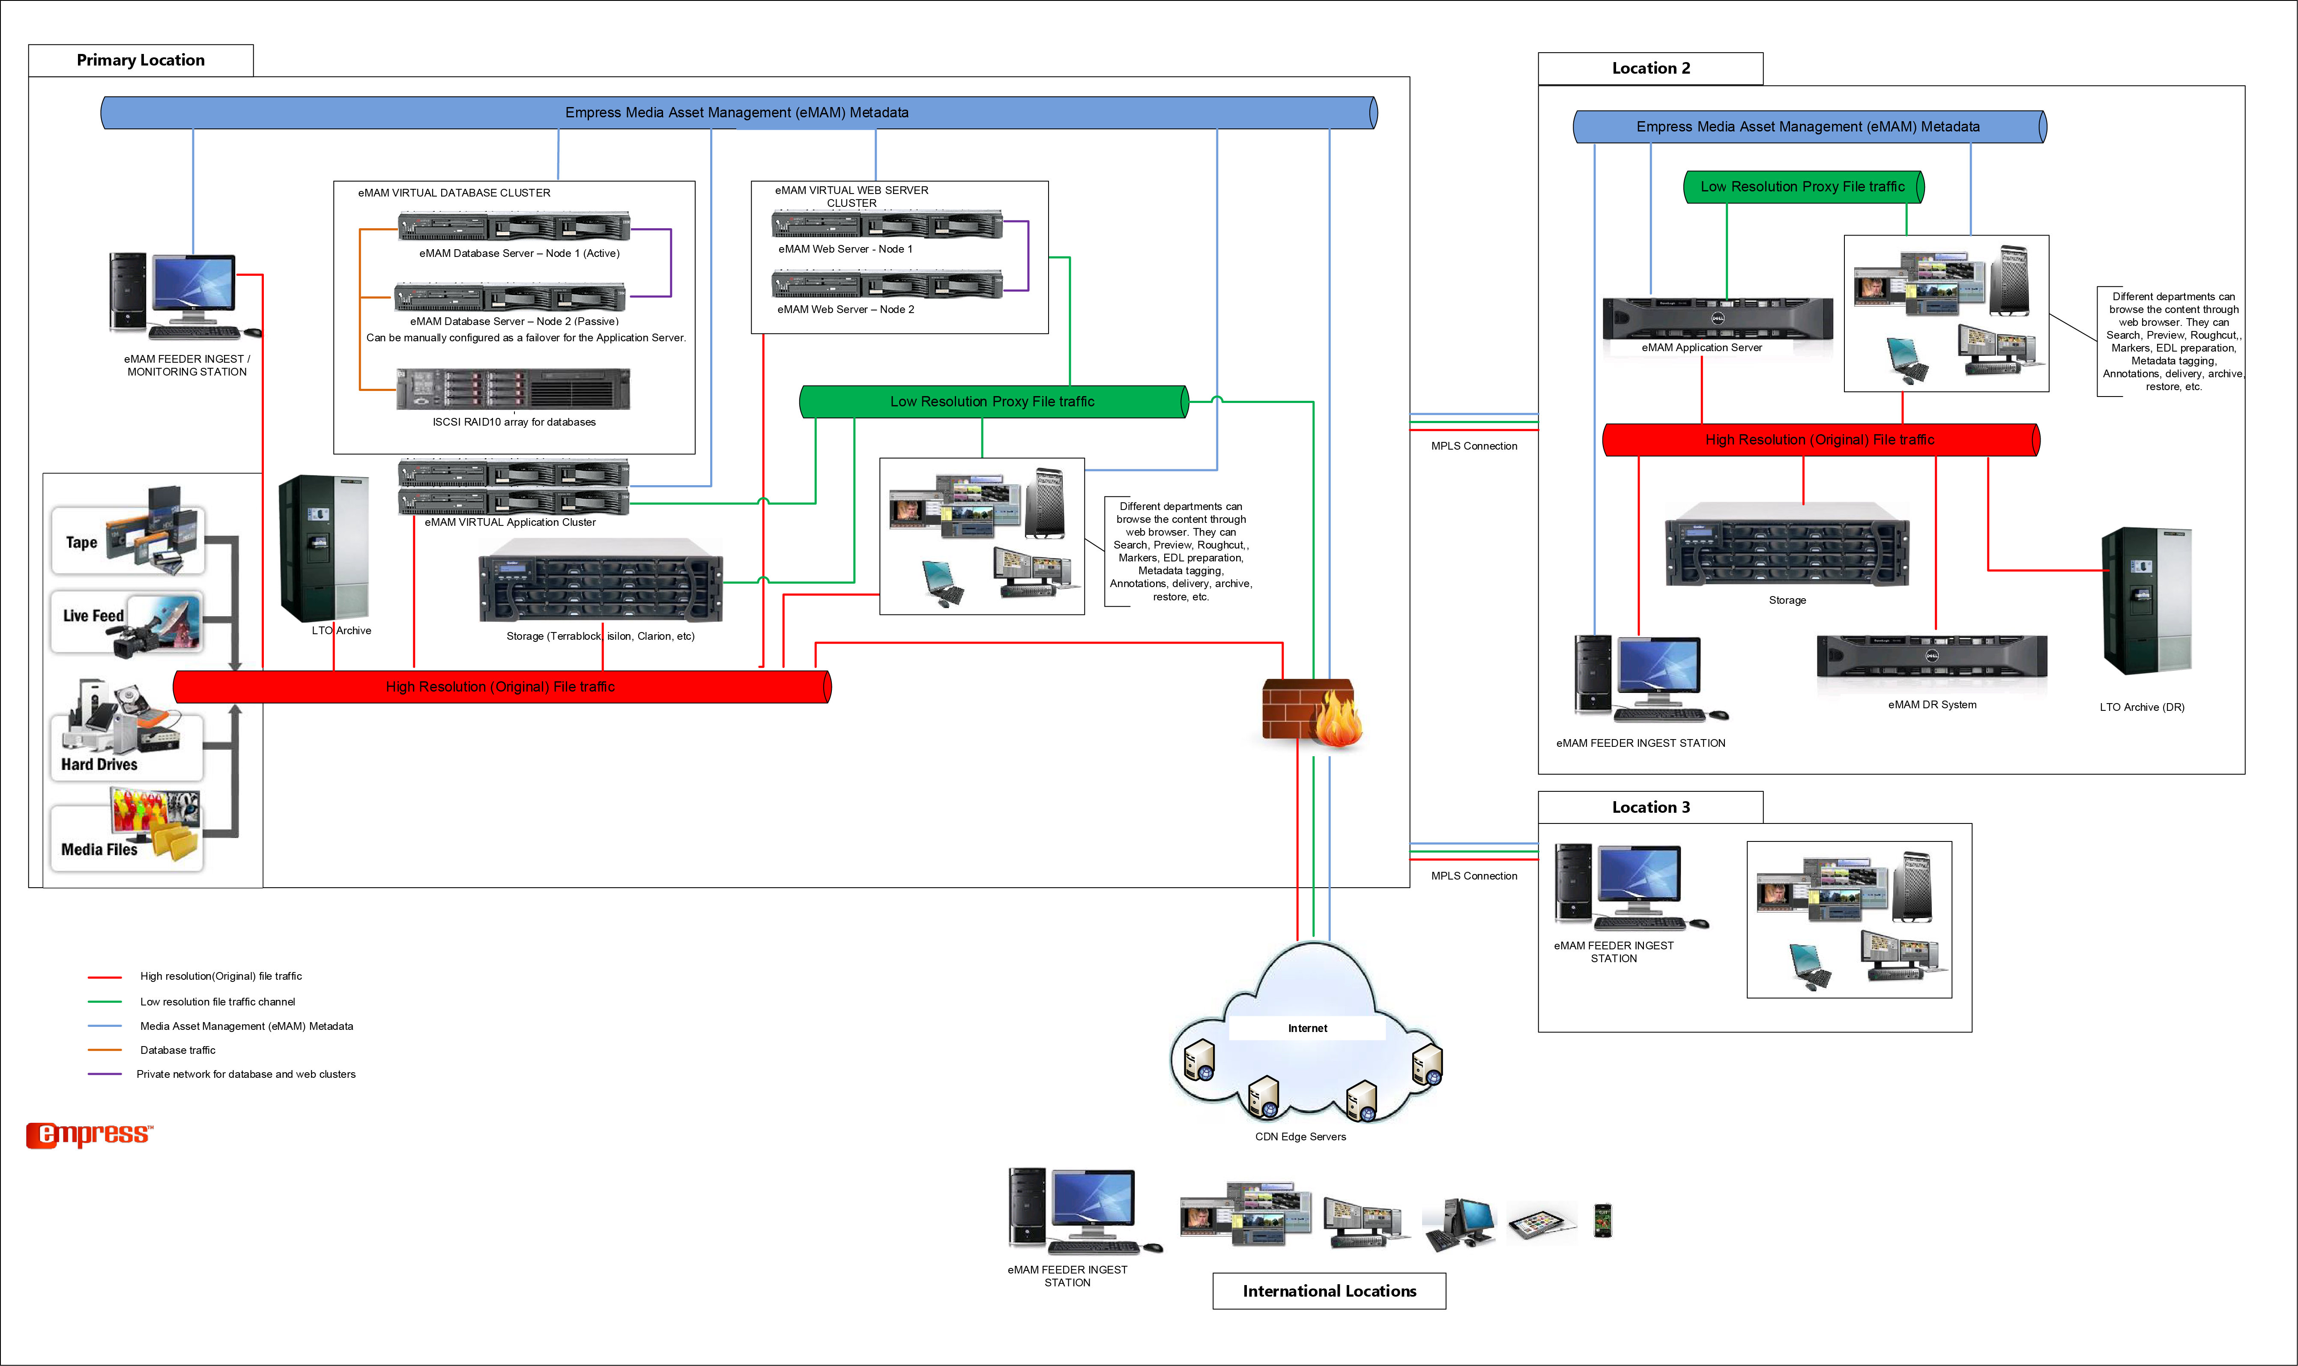
Enterprise Environment
Multi-site EMAM Solution

Slide 25
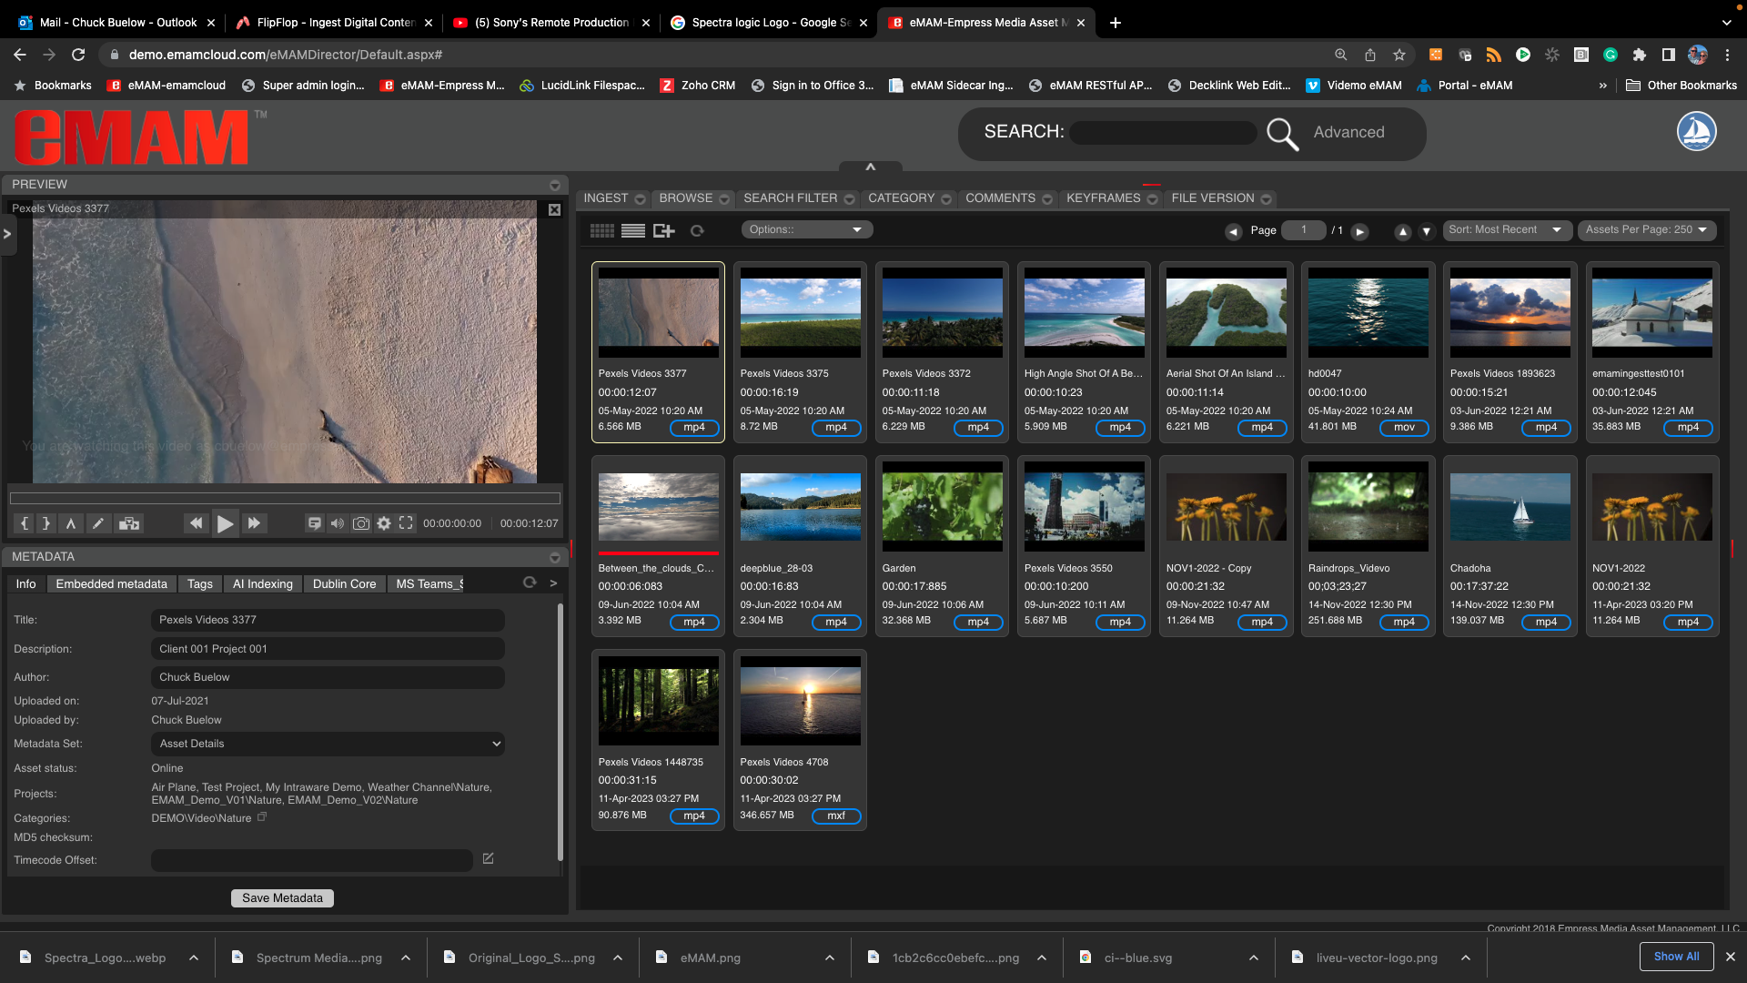
eMAM Web UI
“Director”
Custom Web Interface
Admins and Users design a custom interface
Widgets perform certain functions
Public and Private custom interface
eMAM Support the most popular Web Browsers

Slide 26
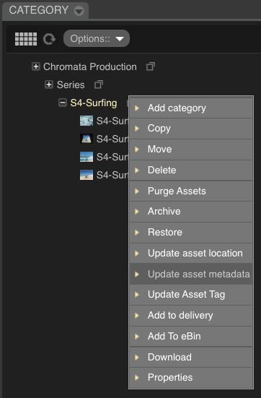
Organize media
Categorize assets
Unlimited categories and subcategories to organize media
Set permission levels to manage access to media
Global updates to metadata and processing of assigned media
Deliver and share groups of media

Slide 27
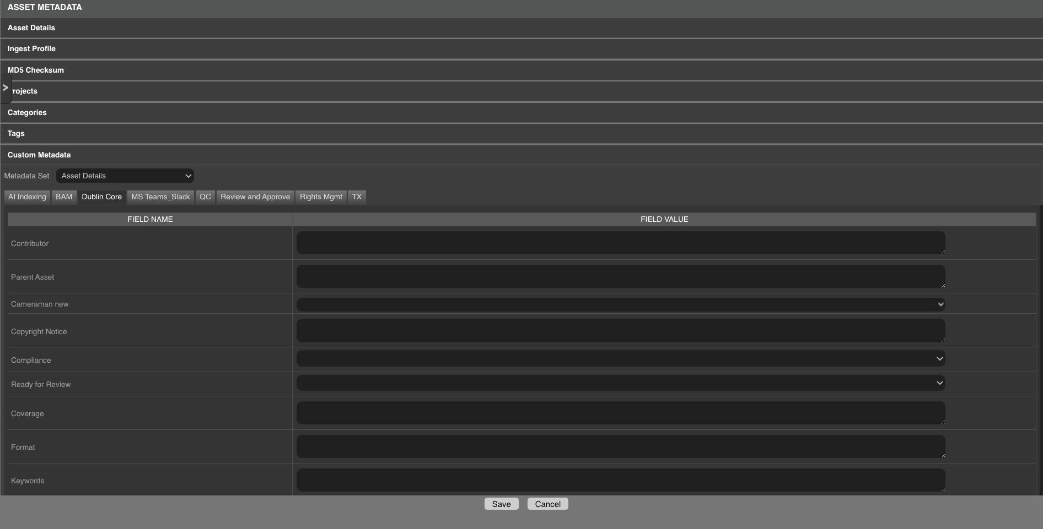
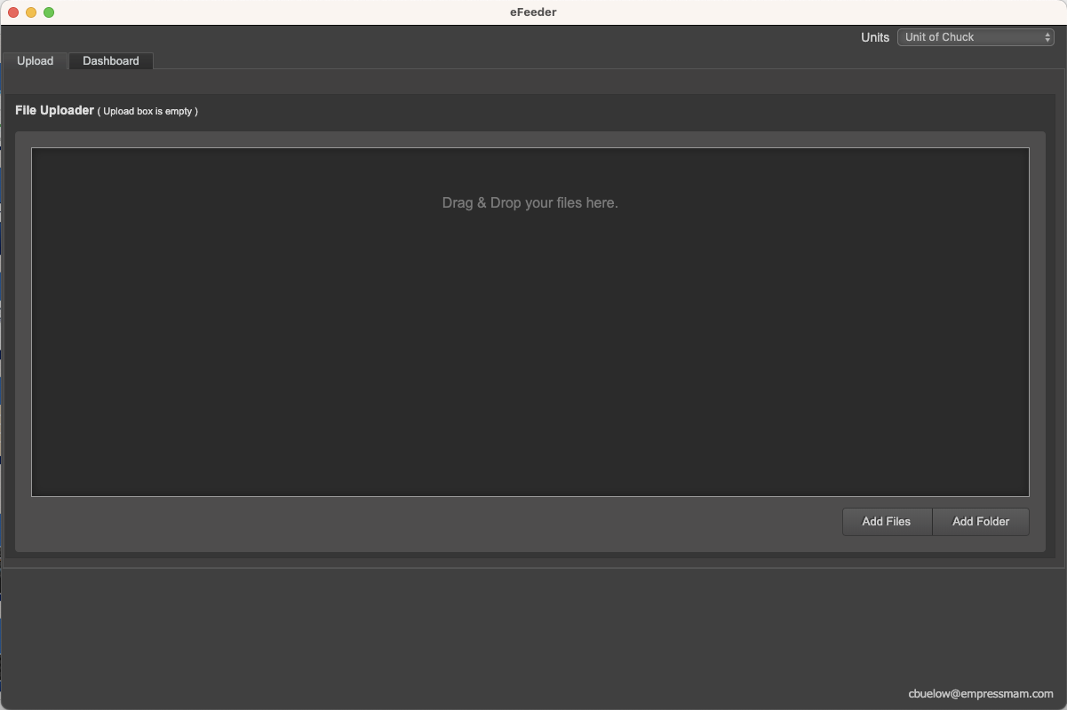
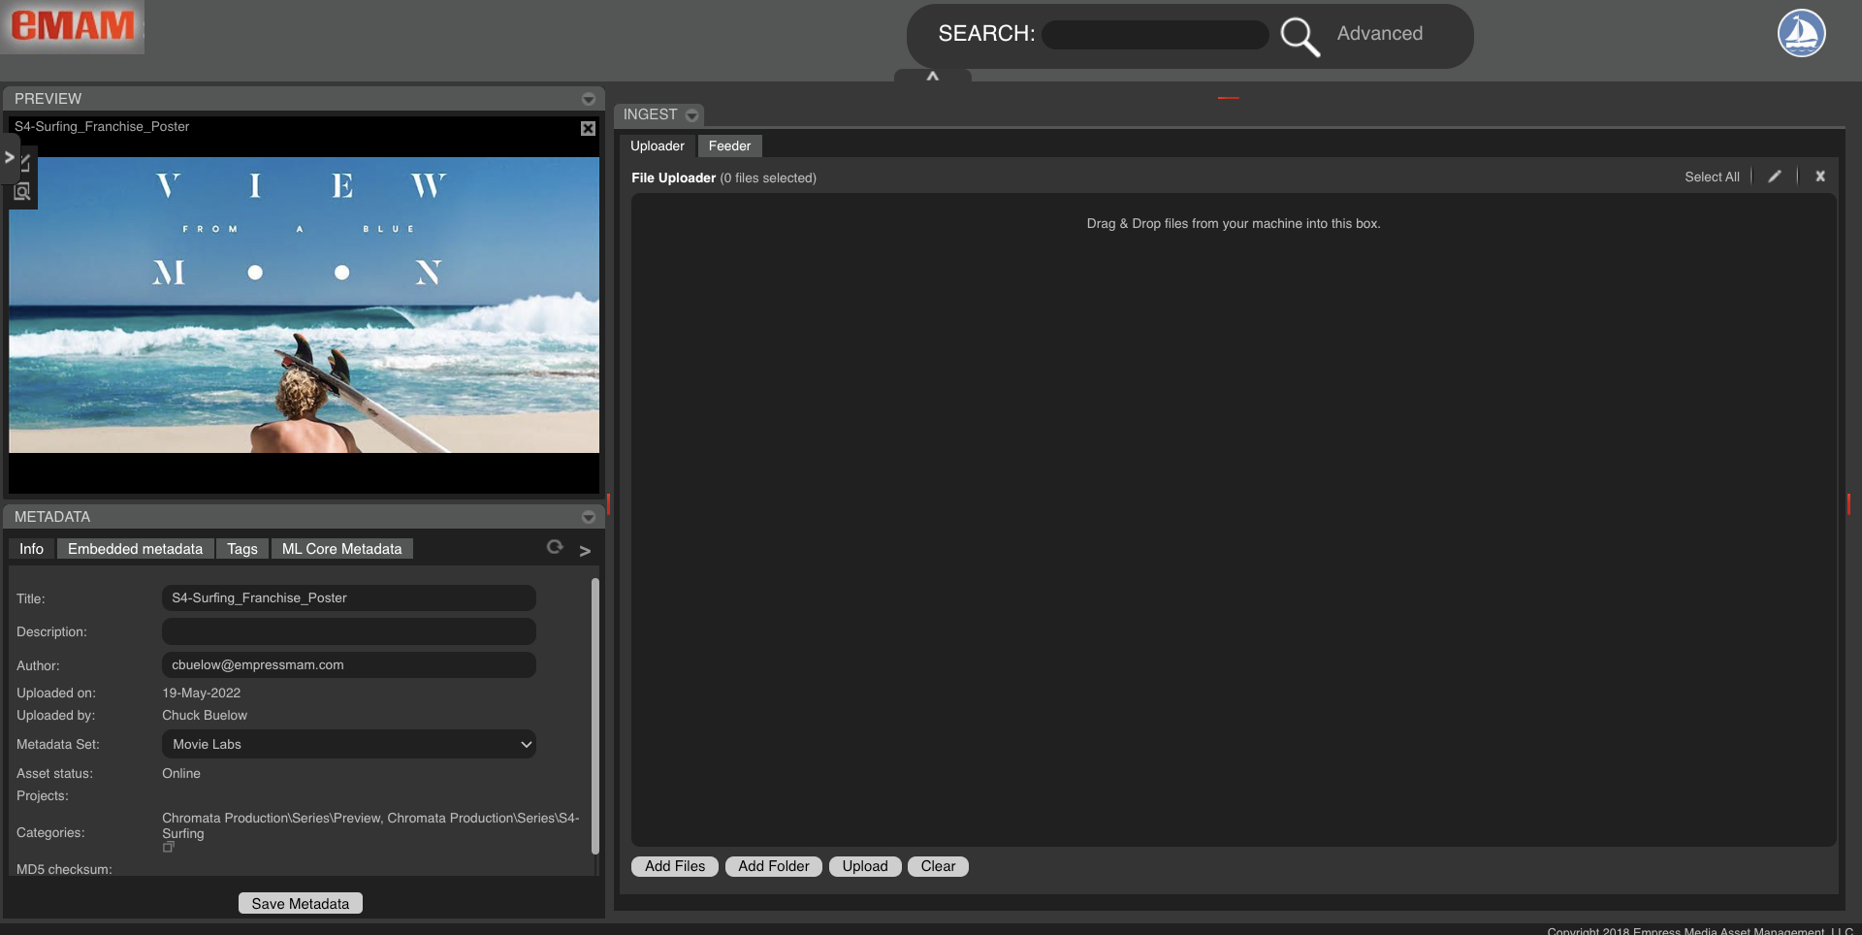
Add Media to eMAM
Ingesting all types of media
eMAM Supports, video, audio, images, graphics and other types of files
Add media through a web UI, or application
Use advanced methods like XML or API commands
3rd party transcoders are used to create proxies and thumbnails

Slide 28
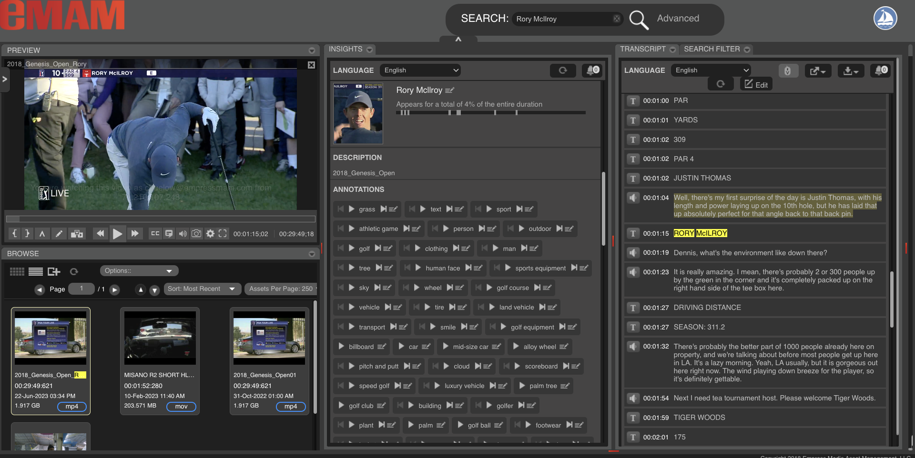
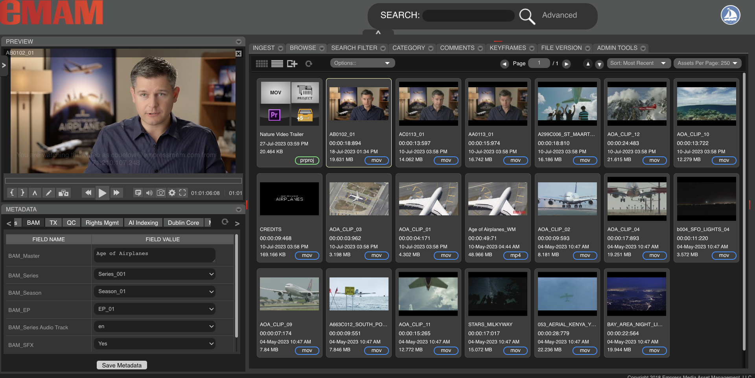
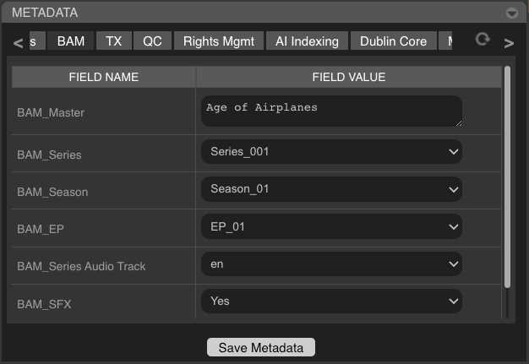
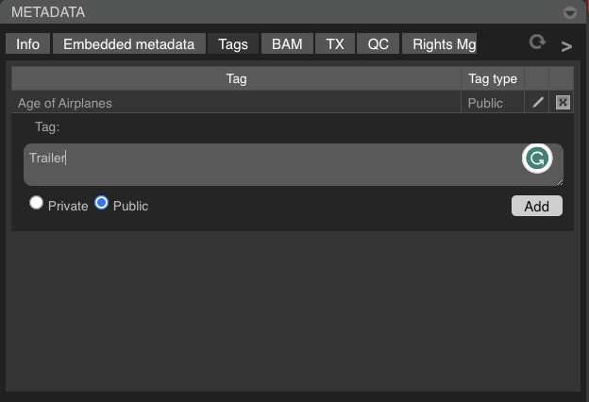
Tag Media
Metadata
Manual and Automated
Custom Metadata Fields
AI Tagging
Bulk updates internal and external

Slide 29
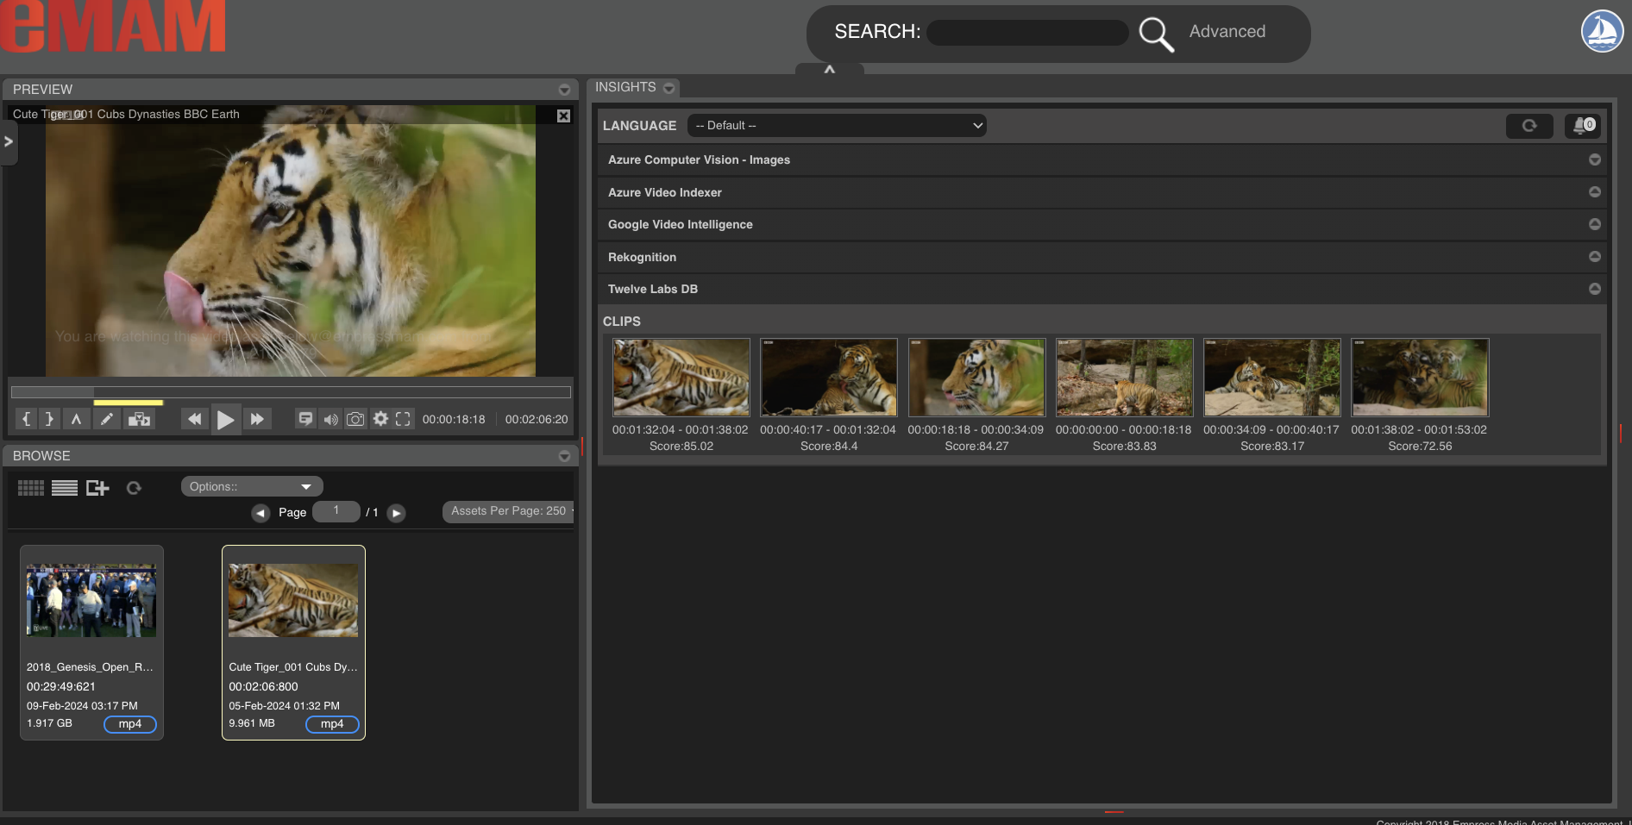
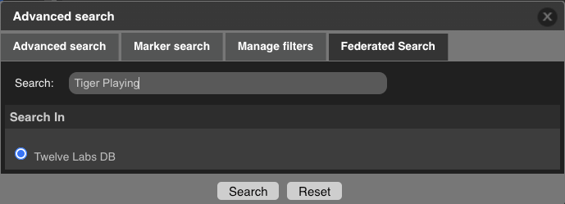
Tag Media
Metadata
Twelve Labs AI Tagging

Slide 30
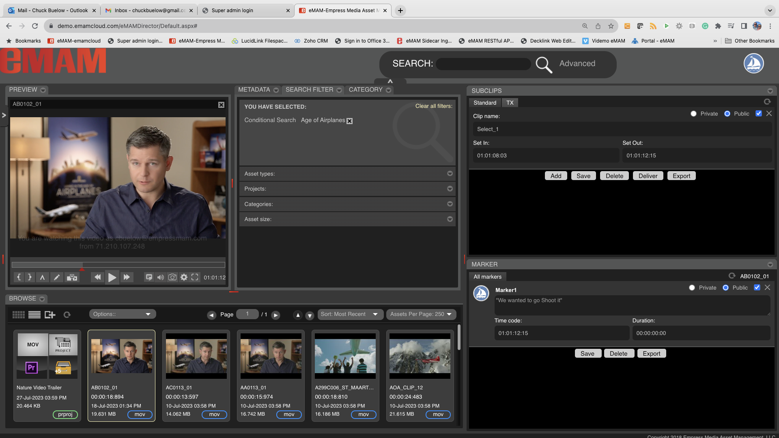
Log Media
Logging media
Log media live or after ingested
Unlimited public or private markers and sub clips
Save, edit, deliver and export markers and sub clips
Markers and sub clips transfer with media to NLE system

Slide 31
Log Media
Logging media
Create sub clips and segments for automated playout
One-click select and preview of sub clips
JKL/IO/M keys supported in player
Set prefix information for sub clips and segments

Slide 32
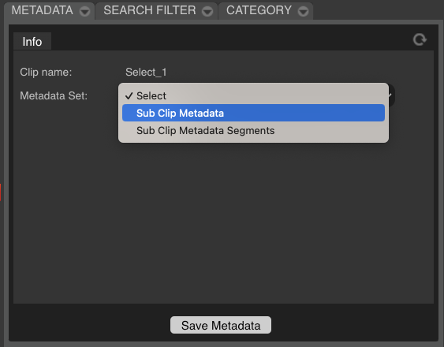
Log Media
Logging media
Create marker and sub clip metadata sets, groups and fields

Slide 33
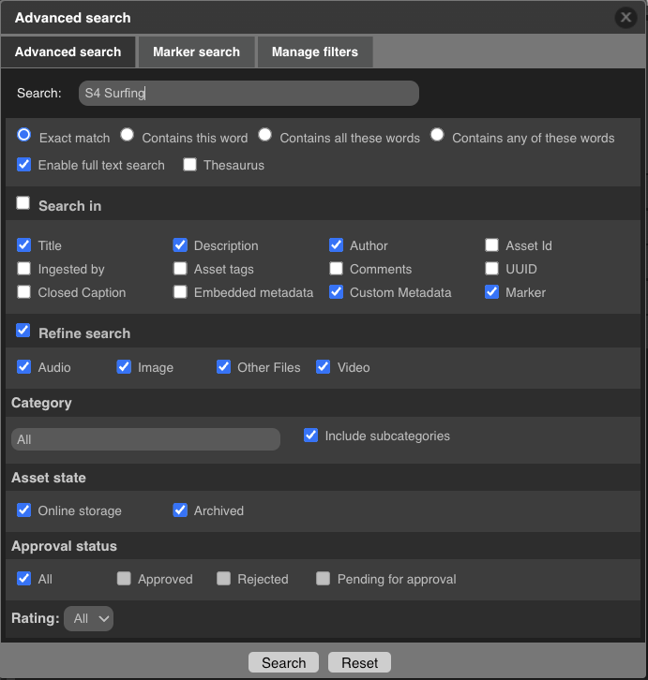
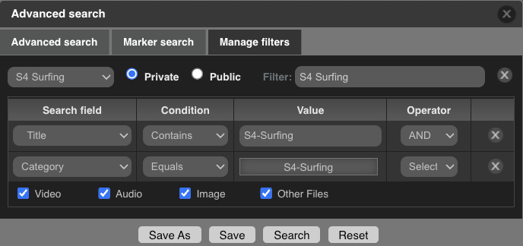
Simple & Advanced Search
Search of word(s), phrases or assignments
Simple search of one or more words
Advanced search on marker information or combined filtering
Search of category or project assignments
Save your searches

Slide 34
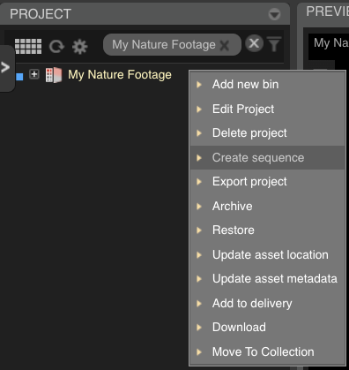
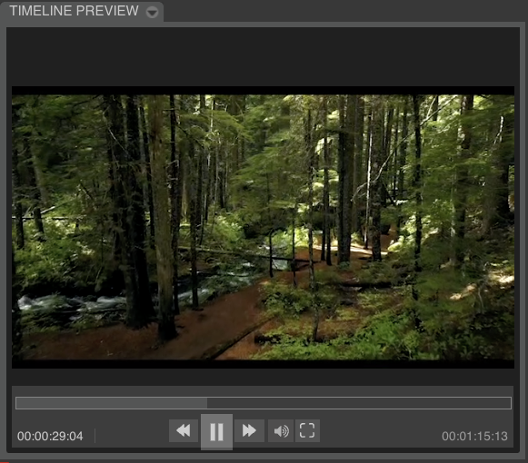
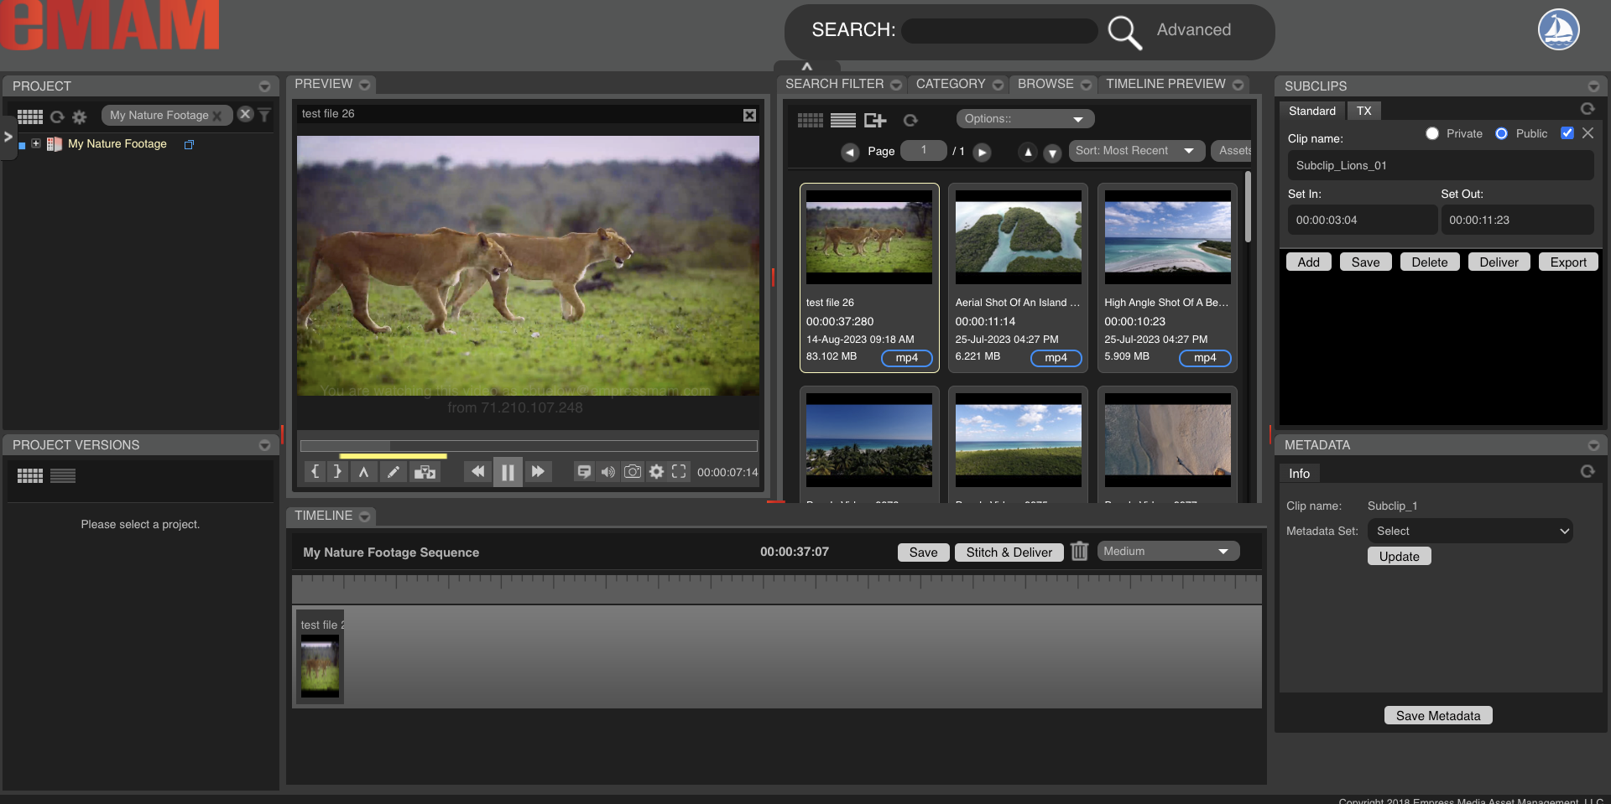
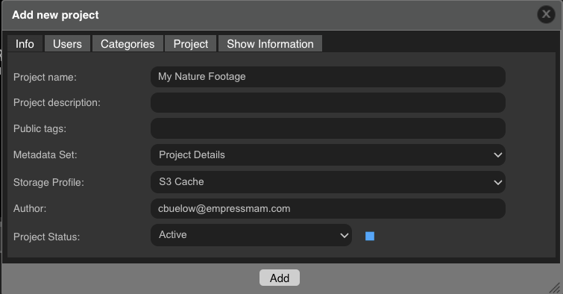
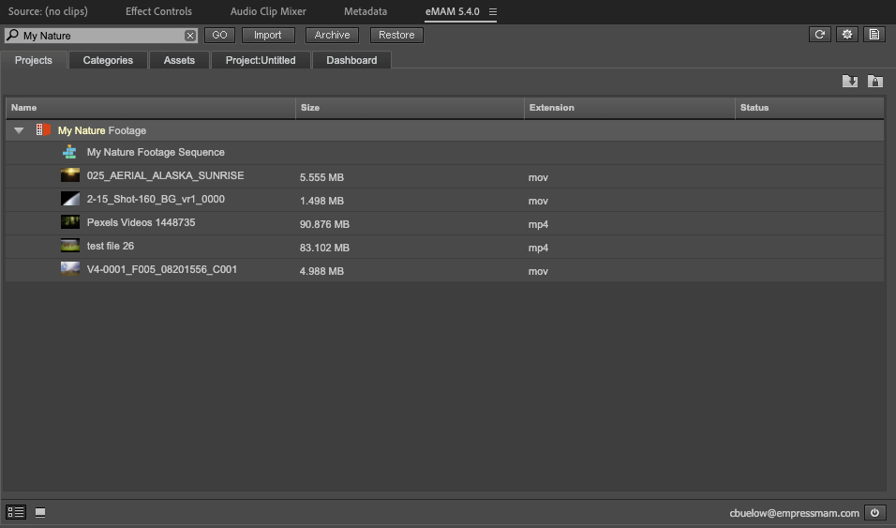
Rough Cut Editing
Rough-Cut Edit inside eMAM
Create eMAM project
Add single track sequence
Add full and sub clips to timeline
Preview and share sequence
Import into Adobe Premiere Pro

Slide 35
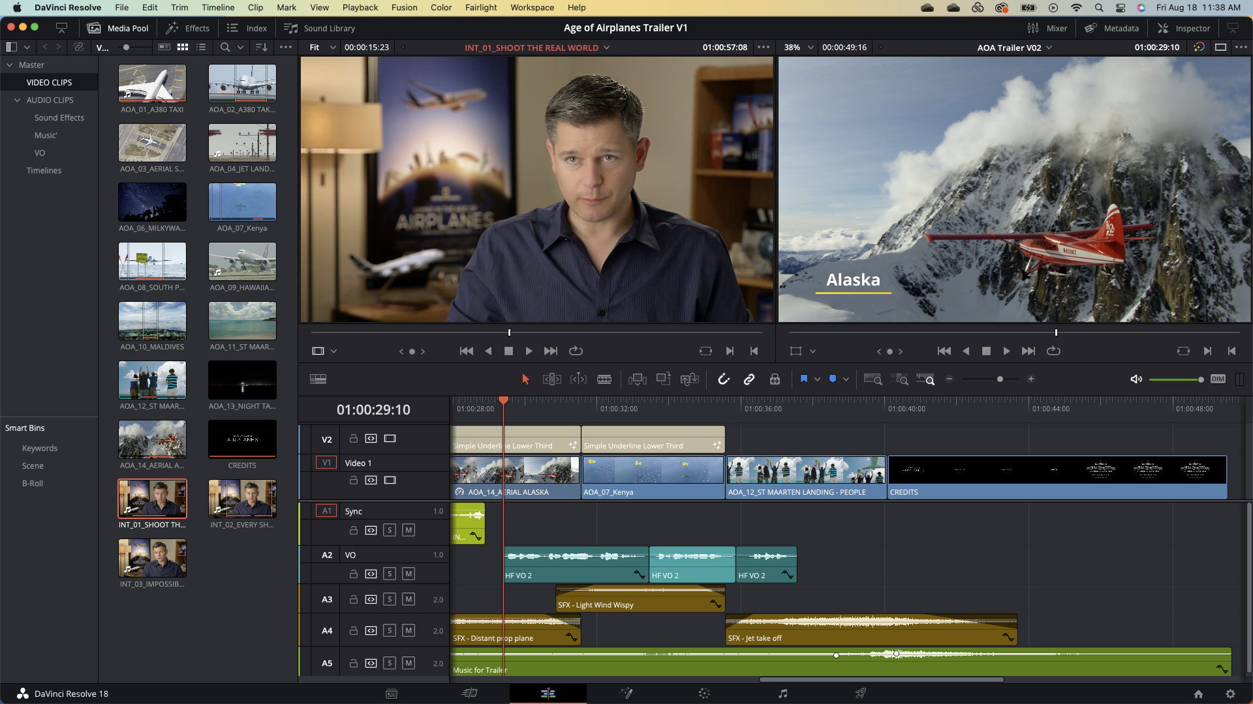
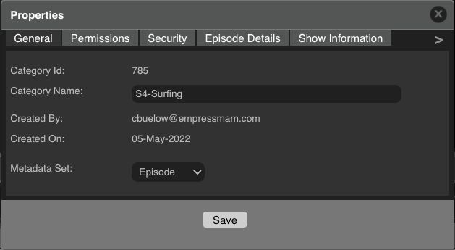
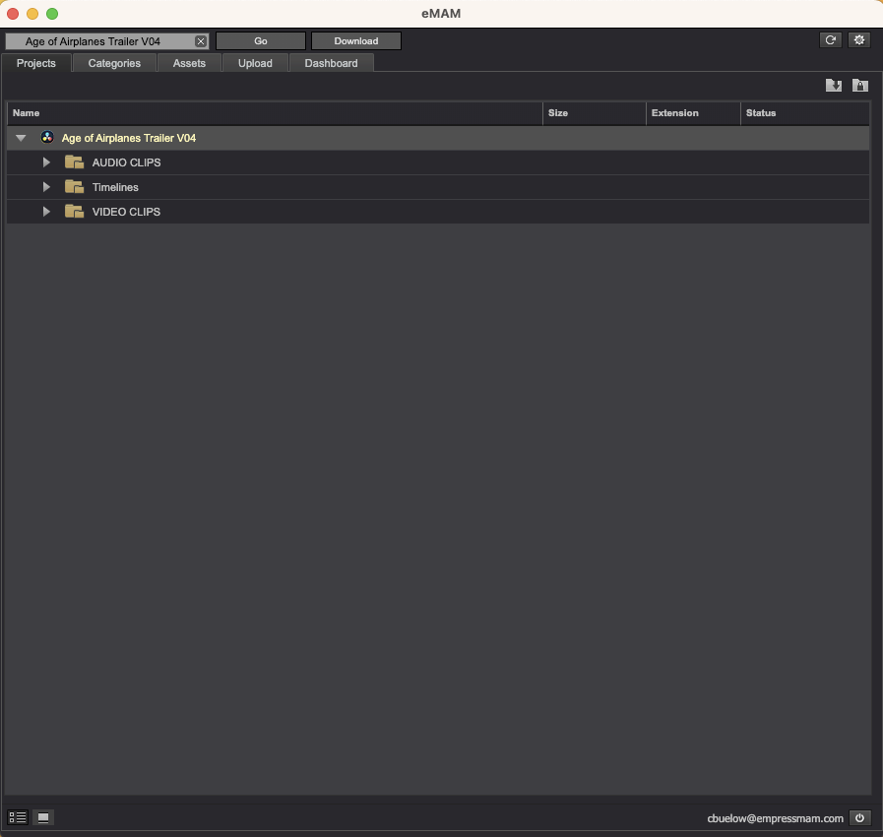
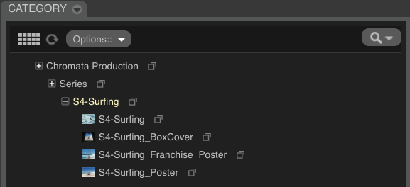
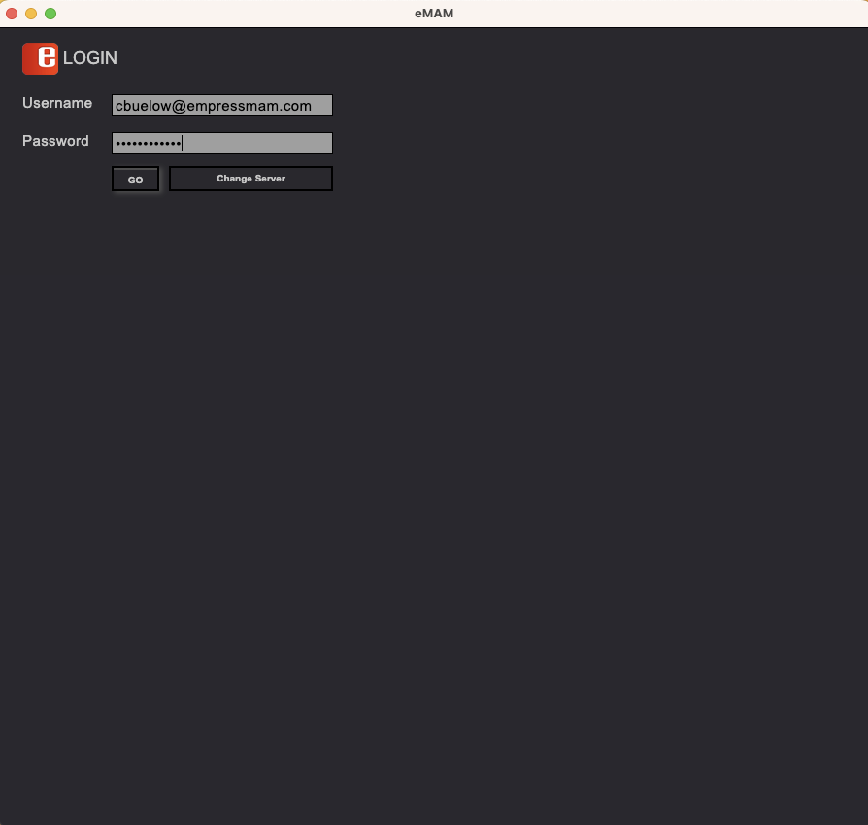
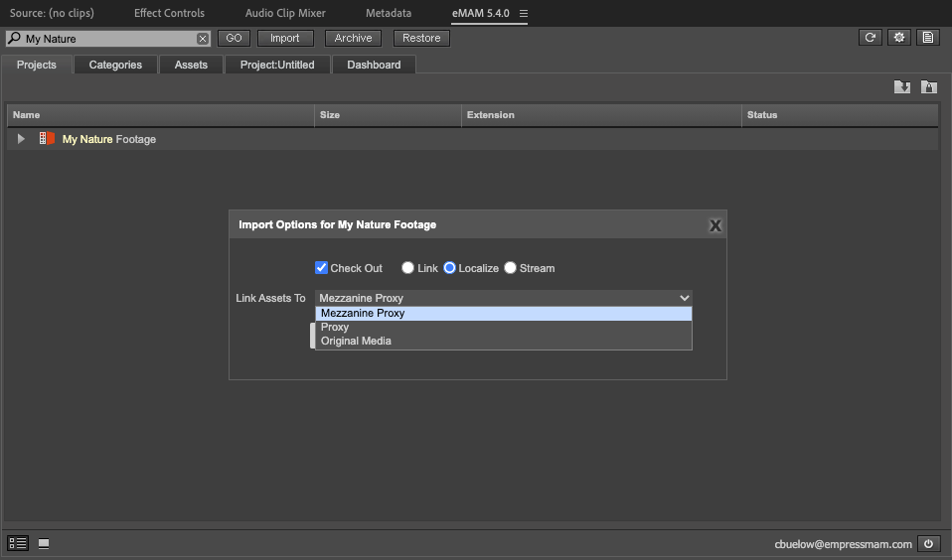
Advanced Production
Video Production using eMAM
Centralize media inside eMAM
Assign media to projects and categories
Assign permissions to media
Import media, categories into DaVinci Resolve, Adobe Creative suite
Export to eMAM to manage projects

Slide 36
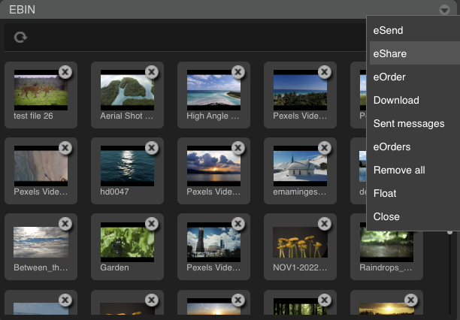
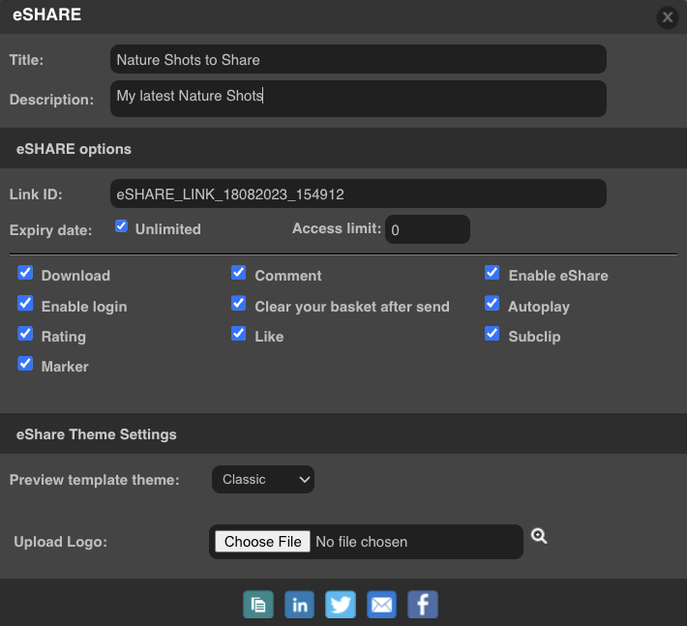
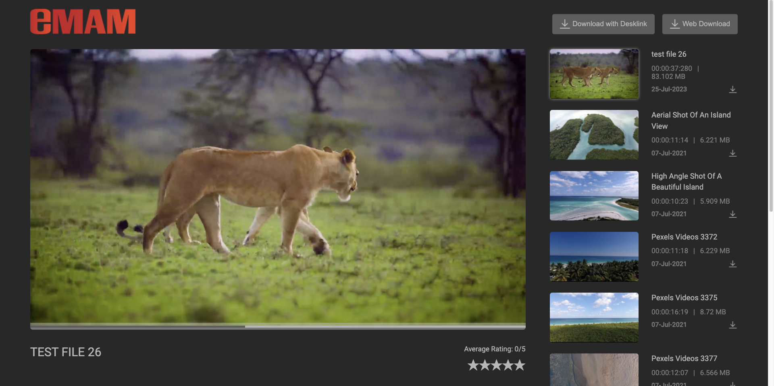
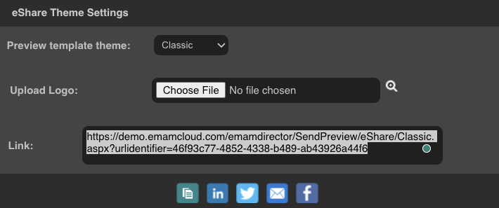
Share and Deliver
Share & Deliver media with eMAM
Search and collect media to share
Use eBIN tools to share media
Select user options
Create link to end in email and view in local browser
Create delivery packages for social media, broadcast and VOD

Slide 37
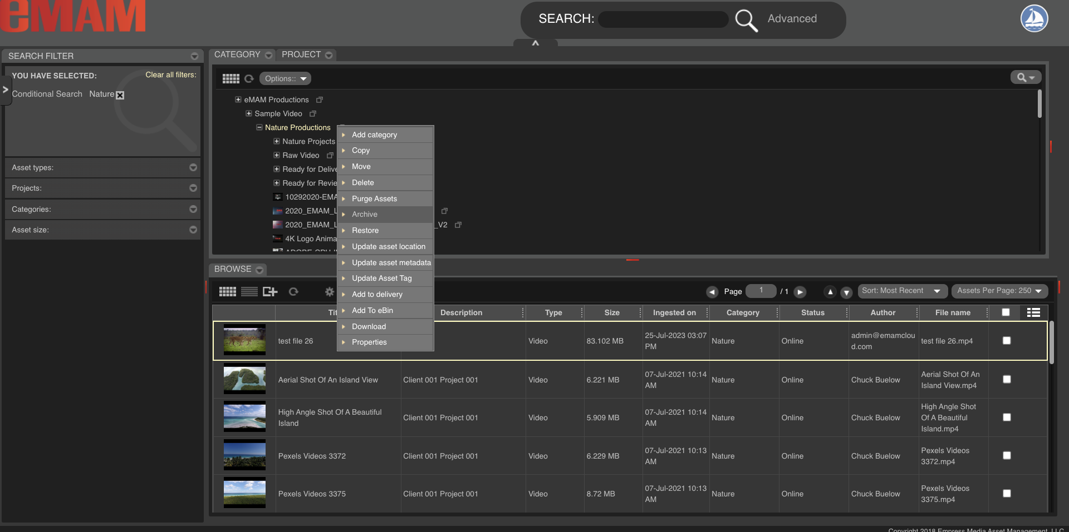
Archive
Archive Media and Projects
Select items to archive by individual assets, categories or projects
Select the archive location; LTO, Spinning Disk or Cloud
Archive in one or more locations
Partial restore on supported archive platforms

Slide 38
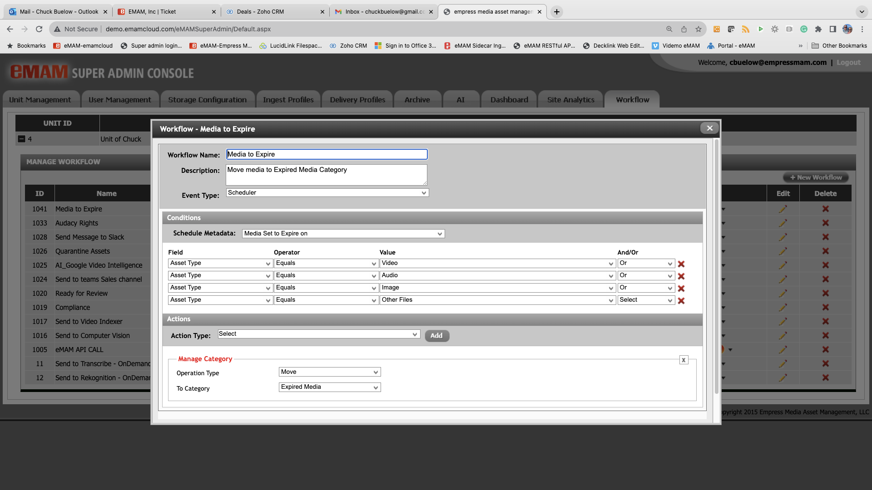
Advanced Workflows
Custom Automated Workflows
Menu driven workflows for simple and advanced workflows
Based on Event, Conditions & actions
Events: Ingest, Metadata Change, Scheduled Date, Asset Info change, Button, & cloud update
Conditions: Status, custom Metadata, Dates Reached, Button Selects..
Actions: Delivery, Archive, Metadata Change, Notify, Purge, Manage Category & Project, AI Index, Proxy Creation

Slide 39
Bundles
Vault
Publish
Workgroup
Enterprise

Slide 40
Vault
eMAM Vault Base System: eMAM Vault storage and archive management system. Ingest, Organize, Delivery Archive, Annotate, Markers, Tags, Sub-clips, Approval (Internal), 5 Users
Vault
Purchase $15,100 USD
Annual Subscription $6,900 USD

Slide 41
Publish
eMAM Publish: Storage, archive management, and publishing system with eBin email link sharing, social media, OVP connections, and external review and approval. Ingest, Organize, Delivery, Archive, Annotate, Markers, Tags, Sub Clips, Review and Approve, Email, Approvals eBin Publishing.
10 active defined users.
Publish
Purchase $21,890 USD
Annual Subscription $10,900 USD

Slide 42
Workgroup
eMAM Workgroup: PAM with storage management, archive management, publishing, and production asset management including editing project support (marker, sub clip, timeline) from the web, tablet, and Adobe Creative Cloud panels. 25 active defined users.
Workgroup
Purchase $45,950 USD
Annual Subscription $22,900 USD

Slide 43
ENTERPRISE
eMAM Enterprise scaled MAM with storage management, archive management, publishing, and production asset management with two of each server components for scaling and/or disaster recovery. Unlimited business units. Ingest, Organize, Deliver, Archive, Annotate, Marker, Tag, Sub Clips, Timeline, eMAM/Premiere Project Management/Versions, Approvals, eBin sharing, 1 Multi-site License.
50 active defined users.
ENTERPRISE
Purchase $90,480 USD
Annual Subscription $44,900 USD

Slide 44
EMAM Cloud
SaaS Service
With SaaS, everything is automatic click and go!
Within a day, you will have a secure cloud system
You will pay a monthly fee, with term discounts available
Starts at $47.90 / Month / User
PaaS Platform
With this Cloud Formation Template, you manage the AWS services
Our software runs on your infrastructure, so you are in control
Our configurations and APIs allow you to build around eMAM
You will be charged hourly, with term discounts available
Starts at $38.10 / Month/User

Slide 45
EMAM Feature Set

Slide 46
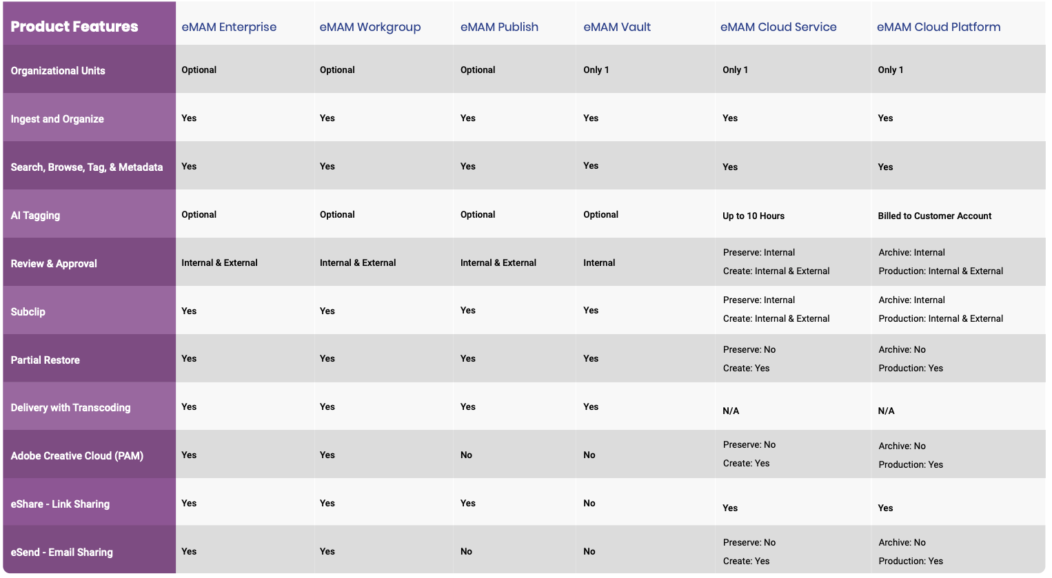
EMAM Feature Set

